Slide 1


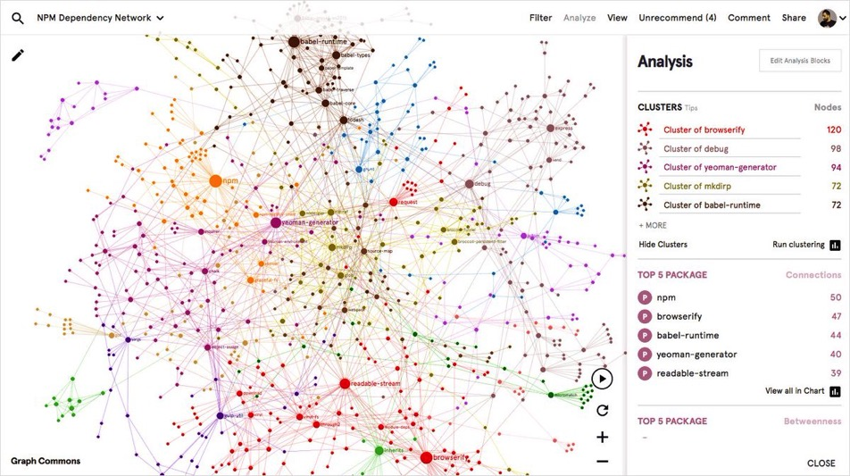
Finnish Changemaker Map

Slide 2
Overview of Ashoka:
Ashoka was founded in 1980 by Bill Drayton, who also coined the term social entrepreneurship.
Ashoka is the world’s largest network for social entrepreneurship and Changemaking, and we are active in over 90 countries​.
We identify and support system-changing social entrepreneurs and our mission is to build and support a Everyone a Changemaker-movement.
Ashoka Nordic was established in 2011 and has partnered so-far with IKEA, Nordea, Accenture, Vinnova, Reach for Change, Raoul Wallenberg Academy and others.
90%
of Fellows have seen their work
replicated by outside groups
93%
of Fellows have influenced public policy
97%
of Fellows report their idea focuses on
societal mindset and cultural change
93%
of Fellows have altered market systems
84%
of Fellows report that Ashoka helped
increase their impact

Slide 3
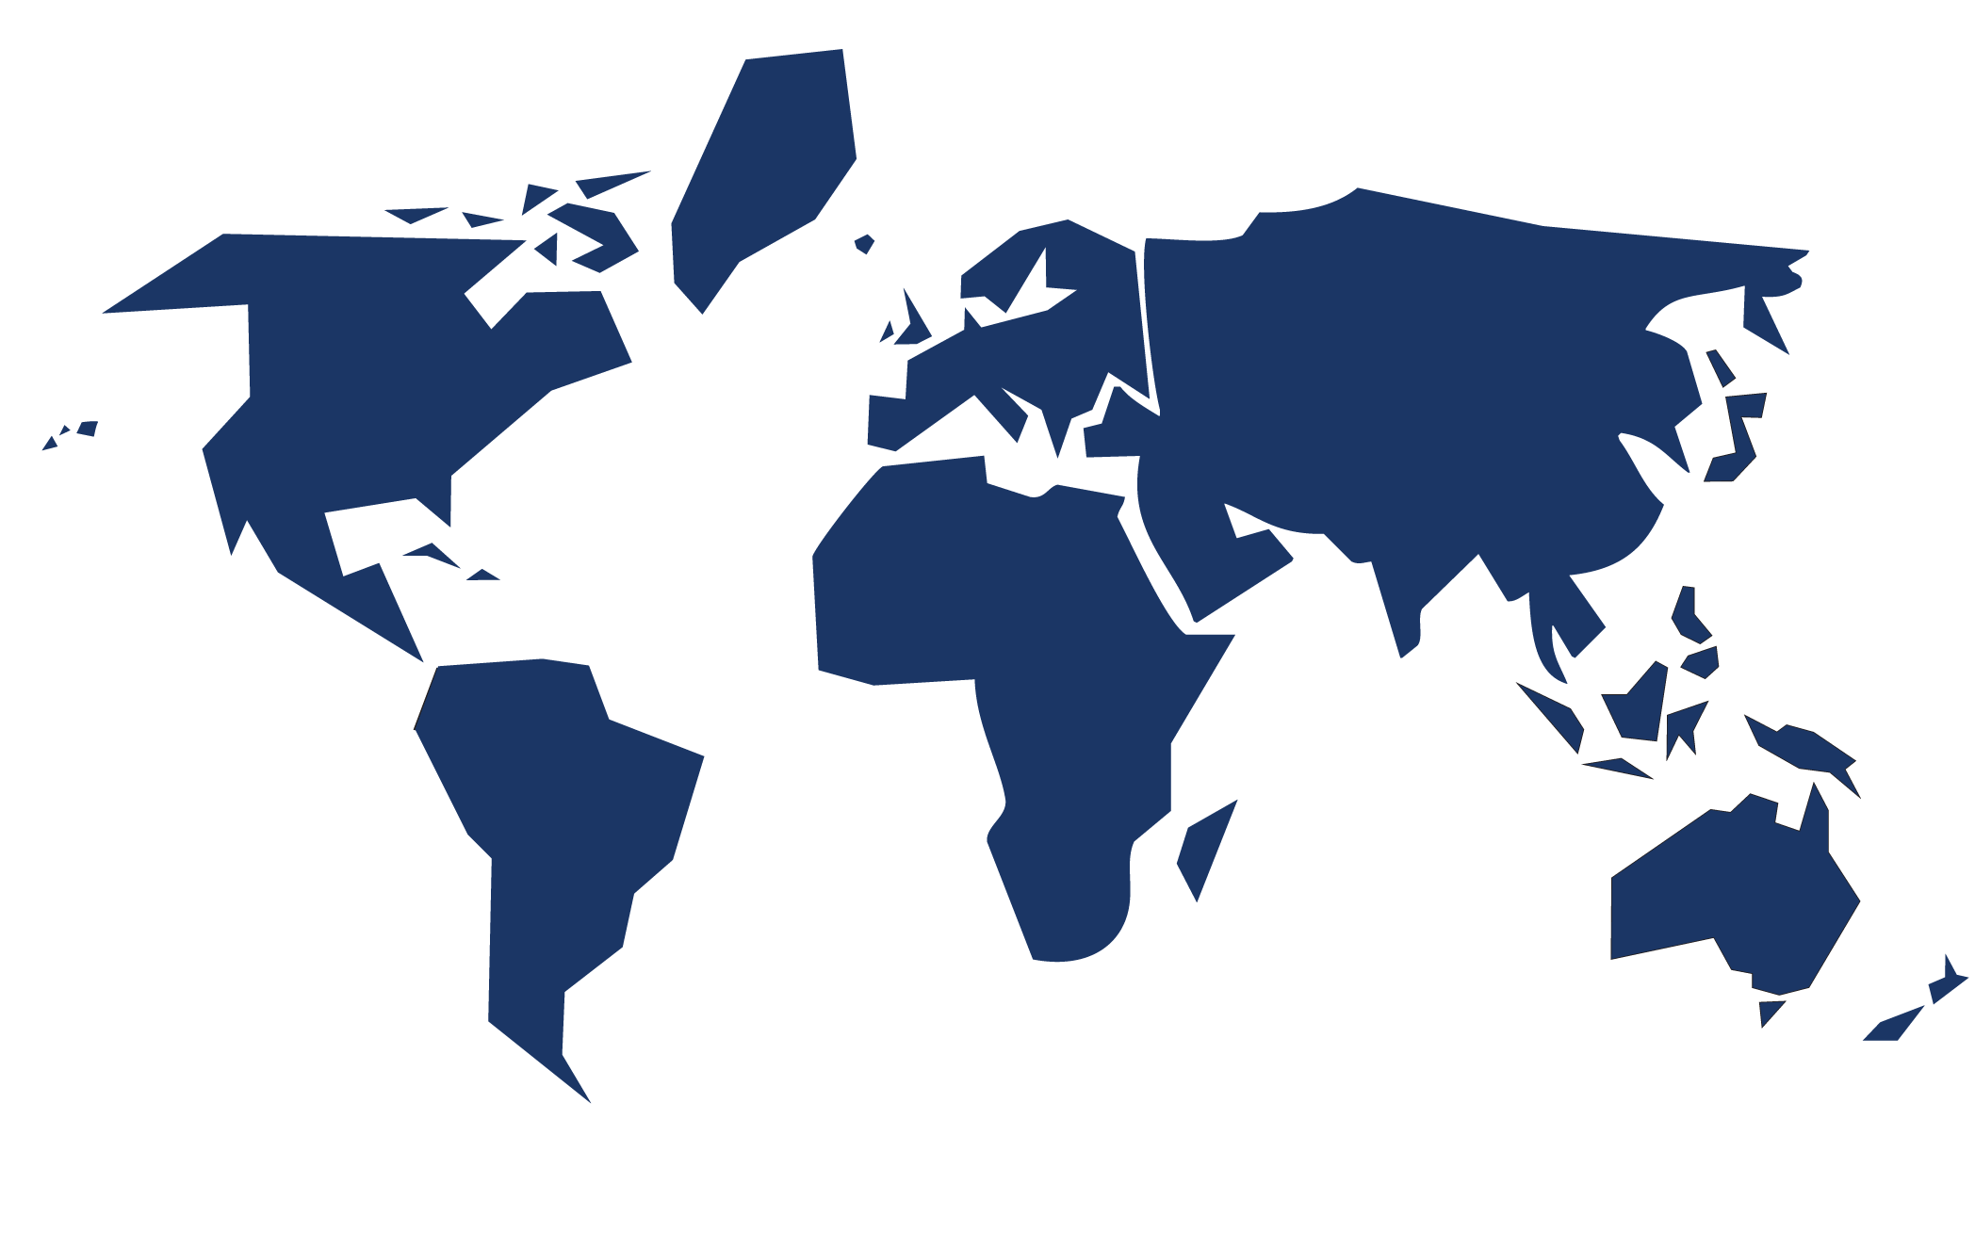


Ashoka
Fellows
Around the World
Nordics
22
Europe
591
North America
320
Middle East and North
Africa
118
Asia
1042
Latin
America
1043
Africa
472
Ashoka Offices Worldwide
Argentina
Austria
Bangladesh
Brazil
Canada
Chile
Egypt
Finland
France
Germany
Greece
India
Indonesia
Ireland
Israel
Italy
Japan
Kenya
Mexico
Netherlands
Nigeria
Nordic
Philippines
Poland
Portugal
Romania
Senegal
South Africa
South Korea
Spain
Switzerland
Thailand
Turkey
United Kingdom
USA
Venezuela
Notes:
Ashoka is the world's largest network of social entrepreneurs – having elected 3500+ Fellows in 40 years. But let me take you through our history so you get a better sense of why we're focused on Everyone-A-Changemaker.
1981. Bill Drayton searches for peoples tackling seemingly intractable, systems-level problems with new ideas and entrepreneurial character. Coins term “social entrepreneurship.” Elects first Ashoka Fellows.
1990. Ashoka identifies early mastery of empathy, teamwork as pattern in Fellows’ trajectories.
2001. “Everyone a Changemaker” introduced, offers vision of immune response to society’s most pressing problems.
2003. Ashoka secures the financial backing of heavyweights like eBay founders Pierre Omidyar and Jeff Skoll as well as billionaire financier Warren Buffett.
2014. Ashoka Fellow Kailash Satyarthi, wins Nobel Peace Prize – having been elected in 1995.
2015. US Secretary of Education Arne Duncan calls changemaking “the new literacy”.

Slide 4

Nordic Changemaker Map

Slide 5
Value proposition
Conduct a health check on the challenges and needs of the ecosystem
Create visibility of existing and needed networks for Nordic Changemakers
Enhance collaborations and connectivity among stakeholders in the ecosystem, nationally and regional
Identify trends to better support, strengthen and evolve the Changemaking scene
Assure a wider understanding of social entrepreneurship and Changemaking in the society

Slide 6
Methodology
The Map will be based on a Snowball Analysis methodology, which offers a scientific and grassroots-led approach enabling an organic approach for nominations/participation in the Map through network recommendations. This to move beyond the "usual suspects" of networks.
The map utilizes both a qualitative (in-depth interviews) and quantitative (online form) way of gathering data, to capture reflections and insights, as well as broader data.
The Map aims to capture 3 categories of Changemakers:
Social entrepreneurs
Young Changemakers
Changemaker Initiatives

Slide 7
Results
Interactive and open-source map to visualize clusters, connections and Changemakers
Roadmap with recommendations from the analysis of the qualitative and quantitively processed data
Event-series with ecosystem actors and Changemakers on key take-aways from map (these can possibly be on social finance, pan-Nordic collaboration, unleashing silos, or tri-sectorial collaboration)
Media coverage through e.g. co-written op-eds, profiles of Changemakers or event coverage
Showcasing the results through alignment at key national, regional or global events such as Skoll World Forum or innovation festivals
Notes:
​

Slide 8
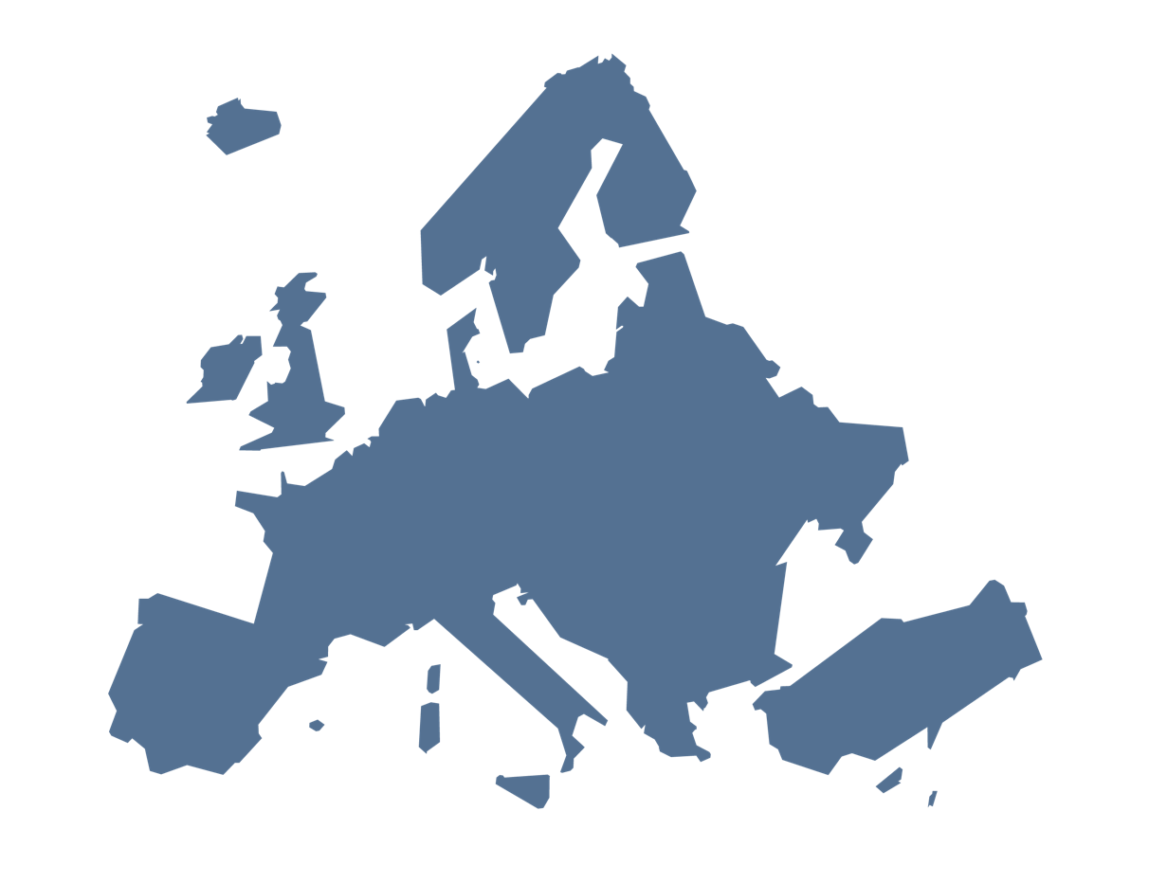




Quick facts Changemaker Map
First mapping in Austria 2014
1,659 unique interviews
7,577 Changemakers nominated to participate
Office of Slovak President uses the Slovak map as a tool for insights and strategy for social innovation
In Austria 2 main newspapers featured the map, as well as 10 stories about the Changemakers
Pilot for Nordic mapping planned to start in May 2020
Norway
Finland
Sweden
Denmark
Poland
Slovakia
Czechia
Hungary
Austria
Romania
Italy
Existing Changemaker Maps
Incoming Changemaker Maps

Slide 9
Nominate a Changemaker!
Vinkkaa muutoksentekijästä!
Tunnetko suomalaisen muutoksentekijän?
Vinkkaa siitä joko somessa tunnisteilla #ChangemakerMap #FinnishChangemaker tai lähetä meille s-postia nordic@ashoka.org
Kriteerit ja lisätietoja löydät täältä:
https://www.ashokanordic.org/finland-changemaker-map

Slide 10

CONTACT
Amanda Sundell
Country Manager Finland asundell@ashoka.org
Nathalie Sajda
Nordic Youth Manager nsajda@ashoka.org
Website:
Facebook:
LinkedIn:
Instagram:
ashokanordic.org
AshokaNordic
AshokaNordic
AshokaNordic

