Slide 1
DEMOCRACY:
POLITICAL SYSTEM AND A WAY OF LIFE
Democracy is a political system in which citizens elect people to decide on shared matters from among themselves
  For example, to the Parliament, municipal council, neighbourhood association, student body board, housing cooperative board
Democracy is a way of life, which can be implemented in all kinds of communities.
  For example, in families, neighbourhoods, schools, workplaces and hobbies
The most important values driving democracy are equality, freedom and justice.
Democracy relies on people’s ability to discuss the common issues and to act while supporting each other
These skills can be practised be participating in the democratic lifestyle.

Slide 2
DEMOCRACY CAN BE PROMOTED
IN MANY WAYS
by voting
by operating through organisations
by taking a position of trust (e.g. in a school, organisation, municipality or company)
by defending equality and justice in different situations (e.g. at work or in school)
by gathering people to discuss the important shared matters
by engaging in public discussion
by engaging in political activities in parties or popular movements
by familiarising yourself with societal issues (e.g. reading books, watching documentaries and following the news)
by helping those in a difficult situation and in danger
...and in many other ways!

Slide 3

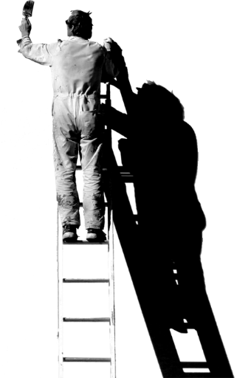
@sitrafund
sitra.fi/en/

